Slide 1
Chapter 4: Grouping Objects
Part 1
toddfadoir.com/java

Slide 2
Concept
Collection
A collection object can store an arbitrary number of other objects.
Examples
Electronic calendars of events
Libraries record details about the books
Universities maintain records of students

Slide 3
How we do this
ArrayList
Our next project…
music-organizer-v1

Slide 4
Class libraries
One of the features of object-oriented languages that makes them powerful is that they are often accompanied by class libraries. These libraries typically contain many different classes that have proved useful to developers on a wide range of different projects.
Java calls its libraries packages. Library classes are used in exactly the same way as we would use our own classes. Instances are constructed using new, and the classes have fields, constructors, and methods.

Slide 5
Importing
import java.util.ArrayList; adds the functionality of the ArrayList class to our current project.
private ArrayList<String> files; creates an ArrayList object that will contain an arbitrary number of strings.

Slide 6
The four methods we will use
The ArrayList class defines quite a lot of methods, but we shall make use of only four at this stage, to support the functionality we require:
add
size
get
remove

Slide 7
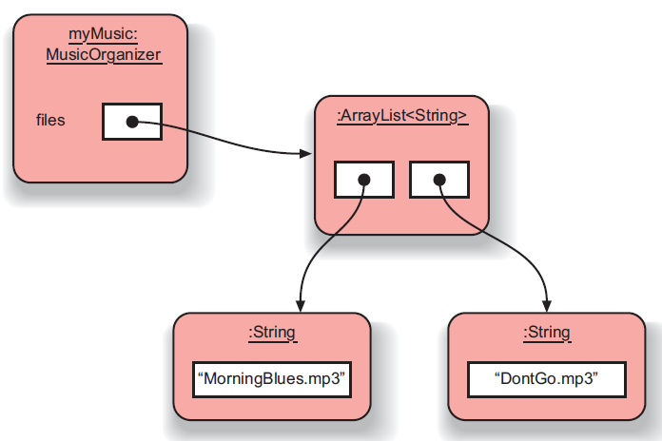

Slide 8
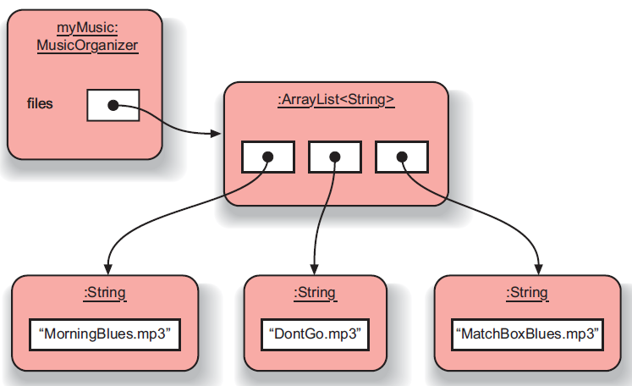

Slide 9
Generic classes
The ArrayList class can be used to specify an ArrayList of String, an ArrayList of Person, an ArrayList of Rectangle, or an ArrayList of any other class that we have available.
For example
private ArrayList<Person> members;
private ArrayList<TicketMachine> machines;
Notes:
Int class, Boolean class

Slide 10
Exercises
4.1 to 4.7

