Slide 1
Chapter 4: Grouping Objects
Part 2
toddfadoir.com/java

Slide 2
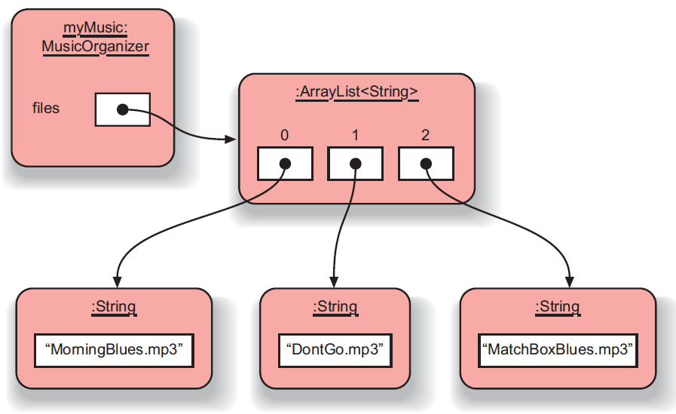
Numbering

Slide 3
Pitfall
If you are not careful, you may try to access a collection element that is outside the valid indices of the ArrayList.
When you do this, you will get an error message and the program will terminate.
Such an error is called an index-out-of-bounds error. In Java, you will see a message about an IndexOutOfBoundsException.

Slide 4
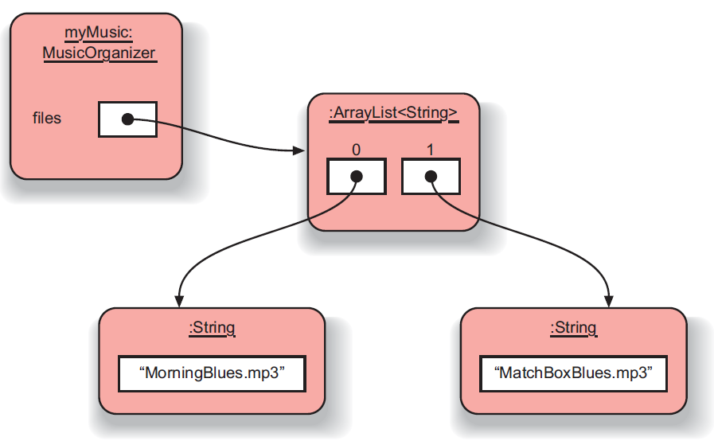
files.remove(1);

Slide 5
Numbering (indexes)
Indexes start at zero.
If the size of the ArrayList is 9, then the last index is 8.
When we remove an item, all the indexes larger than the removed item shift.

Slide 6
Exercises
4.8 to 4.16

