Slide 1
Chapter 4: Grouping Objects
Part 4
toddfadoir.com/java

Slide 2
Working with Strings
String str;
str = "M-PopMuzic.mp3"
"M-PopMuzic.mp3" (String)
str.indexOf(".")
10 (int)
str.indexOf("-")
1 (int)
str.substring(0,0)
"" (String)
str.substring(0,1)
"M" (String)

Slide 3
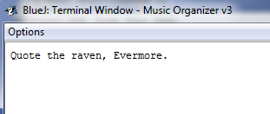
Working with Strings
str = "Quote the raven, Evermore."
"Quote the raven, Evermore." (String)
System.out.println(str);

Slide 4
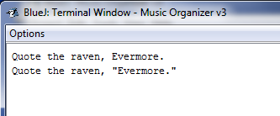
Working with Strings
str = "Quote the raven, \”Evermore.\”"
"Quote the raven, “Evermore.”" (String)
System.out.println(str);

Slide 5
Working with audio
Copy the project “Music Organizer v3” from the x:

Slide 6
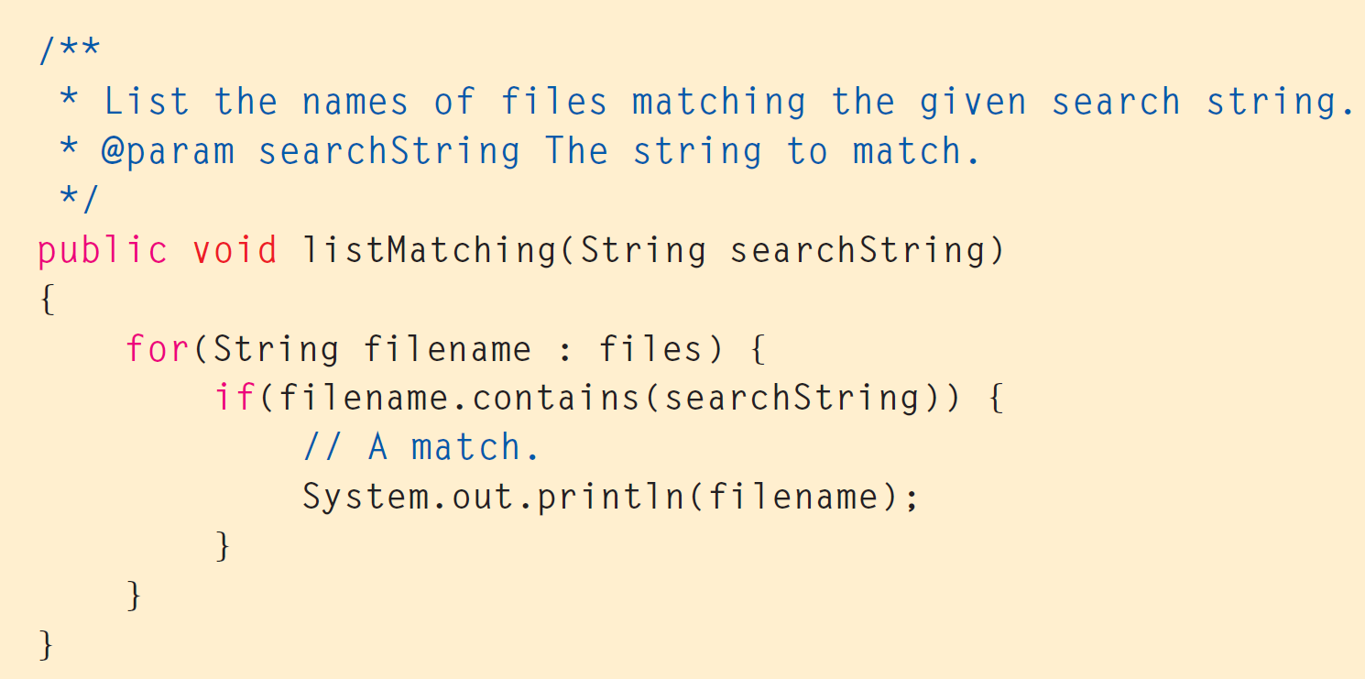
What does this do?

