Slide 1
Chapter 5: More-sophisticated behavior
Part 1
toddfadoir.com/java

Slide 2
Java library & documentation
The Java standard class library contains many classes that are very useful. It is important to know how to use the library.
The Java class library documentation shows details about all classes in the library. Using this documentation is essential in order to make good use of library classes.

Slide 3
Interface & implementation
The interface of a class describes what a class does and how it can be used without showing the implementation.
The complete source code that defines a class is called the implementation of that class.

Slide 4
Signature
The interface of a method consists of the signature of the method and a comment . The signature of a method includes (in this order):
an access modifier (here public), which we shall discuss below;
the return type of the method (here int);
the method name;
a list of parameters (which is empty in this example).

Slide 5
Immutable objects
An object is said to be immutable if its contents or state cannot be changed once it has been created.
Strings are an example of immutable objects.

Slide 6
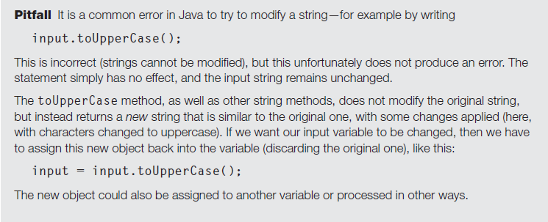

Slide 8
Exercises
5.1 to 5.11

